Slide 1
Matched T-Test
Cohen Chapter 11
For EDUC/PSY 6600

Slide 2
“…we are suffering from a plethora of surmise, conjecture, and hypothesis. The difficulty is to detach the framework of fact – of absolute undeniable fact – from the embellishments of theorists and reporters.”
Sherlock Holmes
Silver Blaze

Slide 3
Motivating examples
Dr. Filburn wishes to assess the effectiveness of a leadership workshop for 60 middle managers. The 60 managers are rated by their immediate supervisors on the Leadership Rating Form (LRF), before and after the workshop.
Dr. Clarke is interested in determining if workers are more concerned with job security or pay. He gains the cooperation of 30 individuals who work in different settings and asks each employee to rate his or her concern about 1) salary level and 2) job security on a scale from 1 to 10.
Dr. Gale questions whether husbands or wives with infertility problems feel equally anxious. She recruits 24 infertile couples and then administers the Infertility Anxiety Measure (IAM) to both the husbands and the wives.

Slide 4
Paired-samples designs
Comparing means of 2 groups
Assumption of independence has been violated resulting in a dependency across groups
Variance of DV smaller as groups consist of same or closely matched cases
Paired-samples t-test also known as…
Matched-, Related-, Correlated-, Dependent-, or Non-independent samples t-test
Repeated-measures t-test
E.g., Members of same family, class, group, litter, twinship
Experimental
Matching groups on some variable(s)
E.g., sex, age, education
↓ potential confounds on IV-DV relationship or when cases cannot receive both conditions
Naturalistic
Samples naturally related, correlated, dependent

Slide 5
Repeated-Measures designs
Successive designs:
2 measurements, conditions, or sets of stimuli are applied to cases sequentially
Before-and-after (or longitudinal ) designs
Pre- / post-test, time 1 / time 2
Cross-over designs
Order effects? Need to counterbalance order
Random subset of cases → A then B
Another random subset of cases → B then A
Counterbalancing may not eliminate carry-over effects
Wash-out period
Simultaneous designs:
2 varying conditions or sets of stimuli inter-mixed w/in study and all cases receive both
No concern for order effects or temporality
Order is generally random

Slide 6
Hypotheses: ‘direct difference’ method
Same as Independent-samples t-test
H₀: μ₁ = μ₂ or μ₁ - μ₂ = 0 or μ₁ - μ₂ = 0
H₁: μ₁ ≠ μ₂ or μ₁ > μ₂ or μ₁ < μ₂
H₀: μ₁ - μ₂ = 0 → H₀: μ_{D} = 0
Compute difference score for each subject
X_{i1} – X_{i2} = D
H₀: μ_{D} = 0 and H₁: μ_{D} ≠ 0
Now equivalent to 1-sample t-test
Mean of difference scores compared w/ H₀: μ_{D} = 0

Slide 7
calculations
M of sample difference scores minus hypothesized population M of difference scores (formula similar to 1-sample t-test)
Divided by sample SE of difference scores
s_{D} = SD of difference scores
N = # of difference scores (pairs)
Critical value: df = N – 1
Number of difference scores (pairs) - 1
Calculated 1 variance or SD
df are half those of independent-samples t-test → larger t_{crit}
Some software programs will not conduct paired-samples t-test
Must 1st transform problem into a 1-sample t-test

Slide 8
Assumptions
Independence of pairs of observations
Normality of sampling distribution of difference scores in population
Equal ns
Pair deleted when 1 member missing data

Slide 9
Paired-Samples t-test and Correlation
Paired-samples t-test almost always more powerful than independent-samples t-test
More likely to reject H₀ when false
Requires fewer subjects
Degree of correlation (r) between scores on 2 groups related to size of difference between paired- and independent-samples t-statistics
Larger correlation → larger difference
Paired-samples t-test calculated as a function of r
When r = 0,
equation reduces to independent-samples t-test
When r > 0
denominator reduces, leading to larger t-statistic
When r < 0
denominator increases, leading to smaller t-statistic
(Rare to have a negative correlation with paired-data)

Slide 10
Confidence Intervals
Are paired sample means significantly different?
Yes: H₀ value not w/in CI
No: H₀ value within CI
In-class example:
95% CI around μ_{D}
Rewrite:
As:

Slide 11
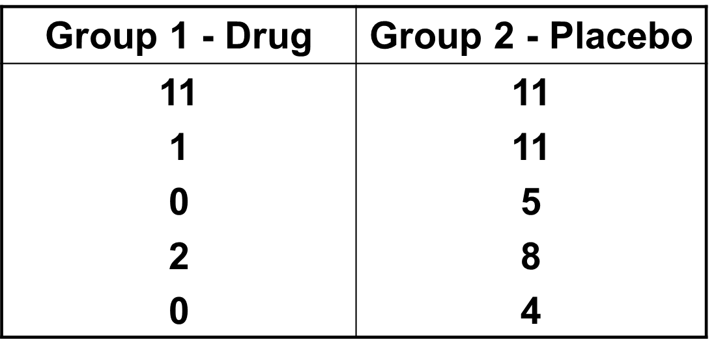
example
Same example from independent-samples t-test lecture
But suppose participants were carefully matched into pairs based on their level of depression prior to initiation of study
One member of each pair was randomly assigned to drug group, other to placebo group
After 6 months, level of depression was measured by a psychiatrist
Need to conduct paired-samples t-test due to matching

Slide 12
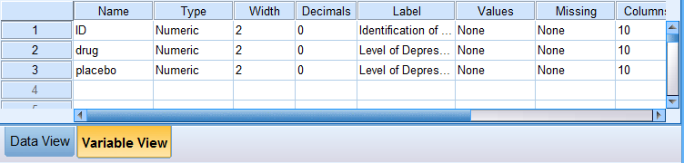
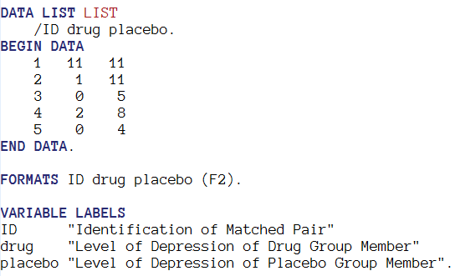
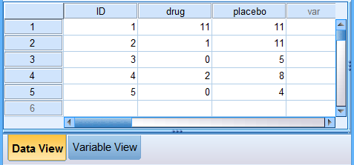
SPSS
1. Get the data into SPSS
2. Summarize & plot to check assumptions
3. Do the Matched Pairs t-Test

Slide 13
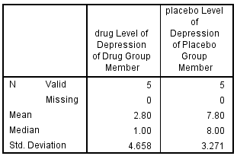
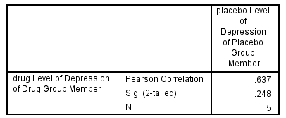
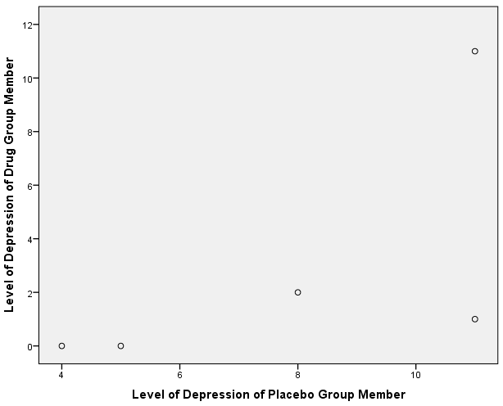

SPSS
1. Get the data into SPSS
2. Summarize & plot to check assumptions
3. Do the Matched Pairs t-Test

Slide 14
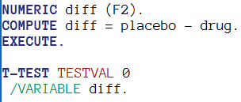
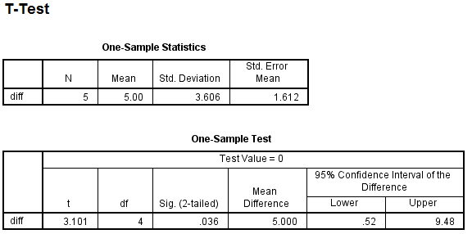
SPSS
1. Get the data into SPSS
2. Summarize & plot to check assumptions
3. Do the Matched Pairs t-Test
DIRECT DIFFERENCE APPROACH…

Slide 15
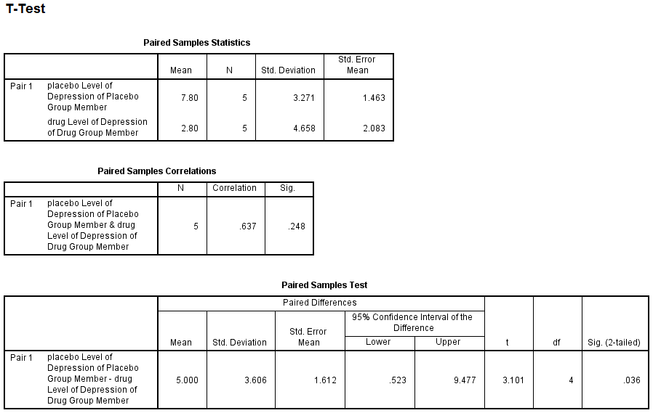
SPSS
1. Get the data into SPSS
2. Summarize & plot to check assumptions
3. Do the Matched Pairs t-Test
MATCHED PAIRS APPROACH…

Slide 16
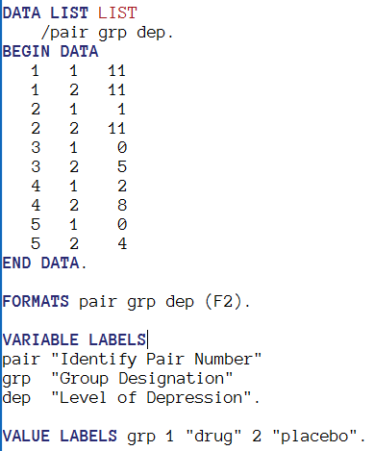
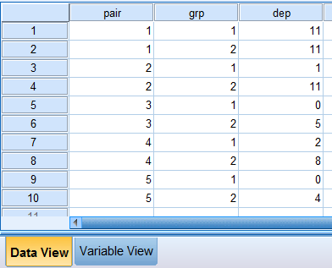
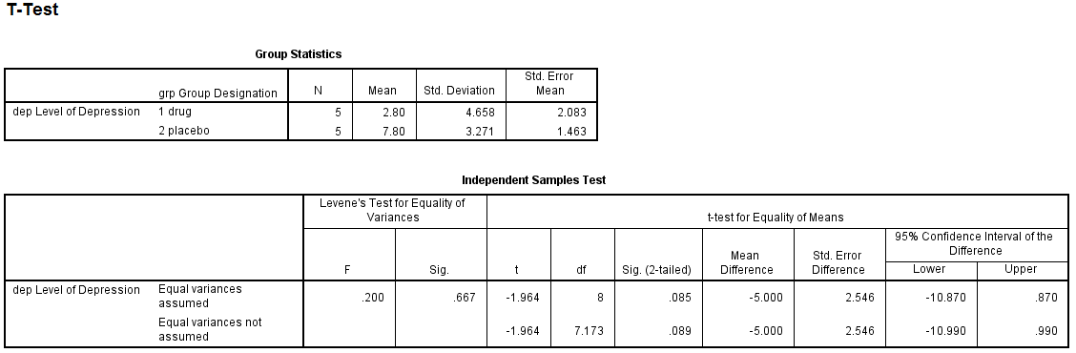

SPSS: INDEPENDENT groups

Slide 17
Effect Size
*Cohen’s d (same as in 1-sample t-test)
Eta squared (η²)
In-class example:

Slide 18
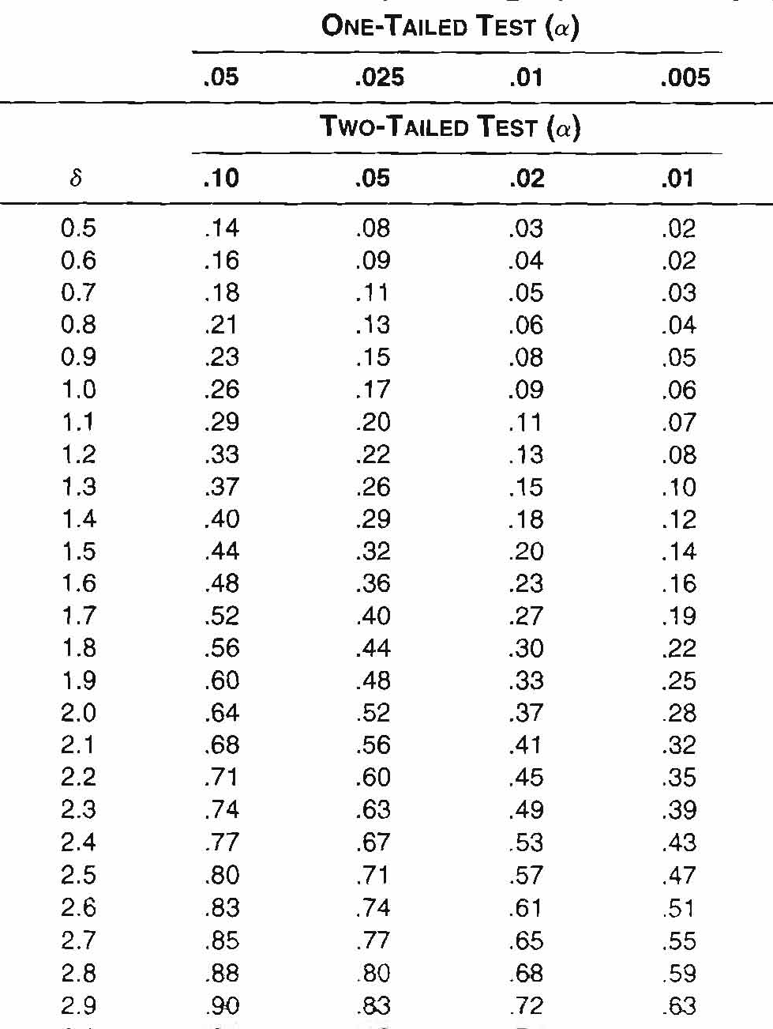
Power Analysis
Post hoc
With Cohen’s d estimate and # pairs,
compute delta to obtain power of study
A Priori
With desired power, compute delta and combine
with estimated Cohen’s d to obtain # pairs (N)

Slide 19
Weaknesses
Reduction in df for critical value
Lack of a control group (sometimes)
If samples are not truly matched, results will be spurious

Slide 20
Alternatives
Violation of normality
Matched-pairs Wilcoxon Test
Binomial Sign Test for Two Dependent Samples
Sample Re-use methods
Exact tests
Randomization and permutation tests

